Slide 1

Health and Wellbeing

Slide 2
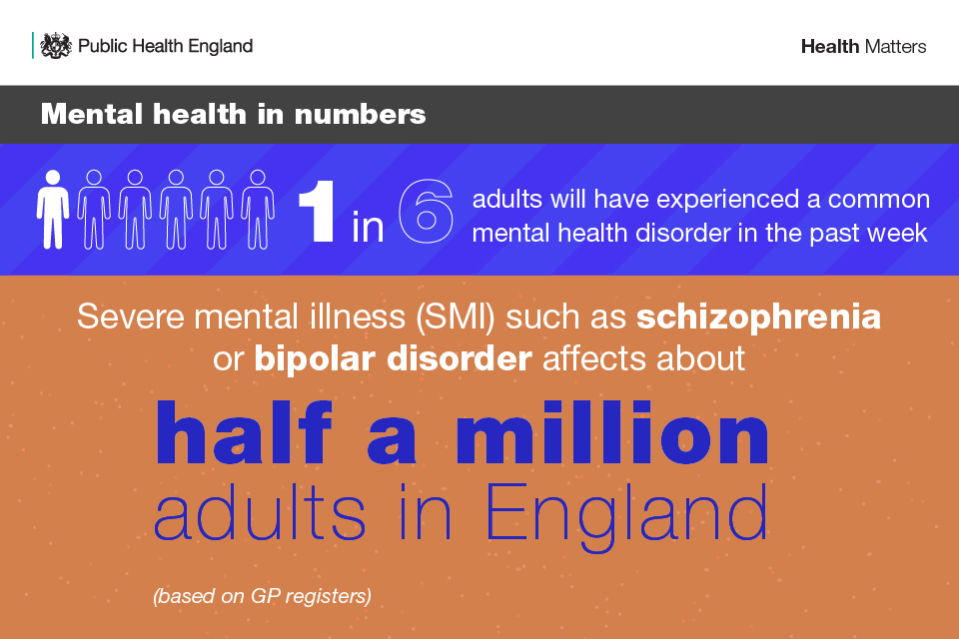
Mental health
Mental health problems are common, with 1 in 6 adults reporting a common mental health disorder, such as anxiety, and there are close to 551,000 people in England with more severe mental illness (SMI) such as schizophrenia or bipolar disorder.
Problems are often hidden, stigma is still widespread, and many people are not receiving support to access services.

Slide 3
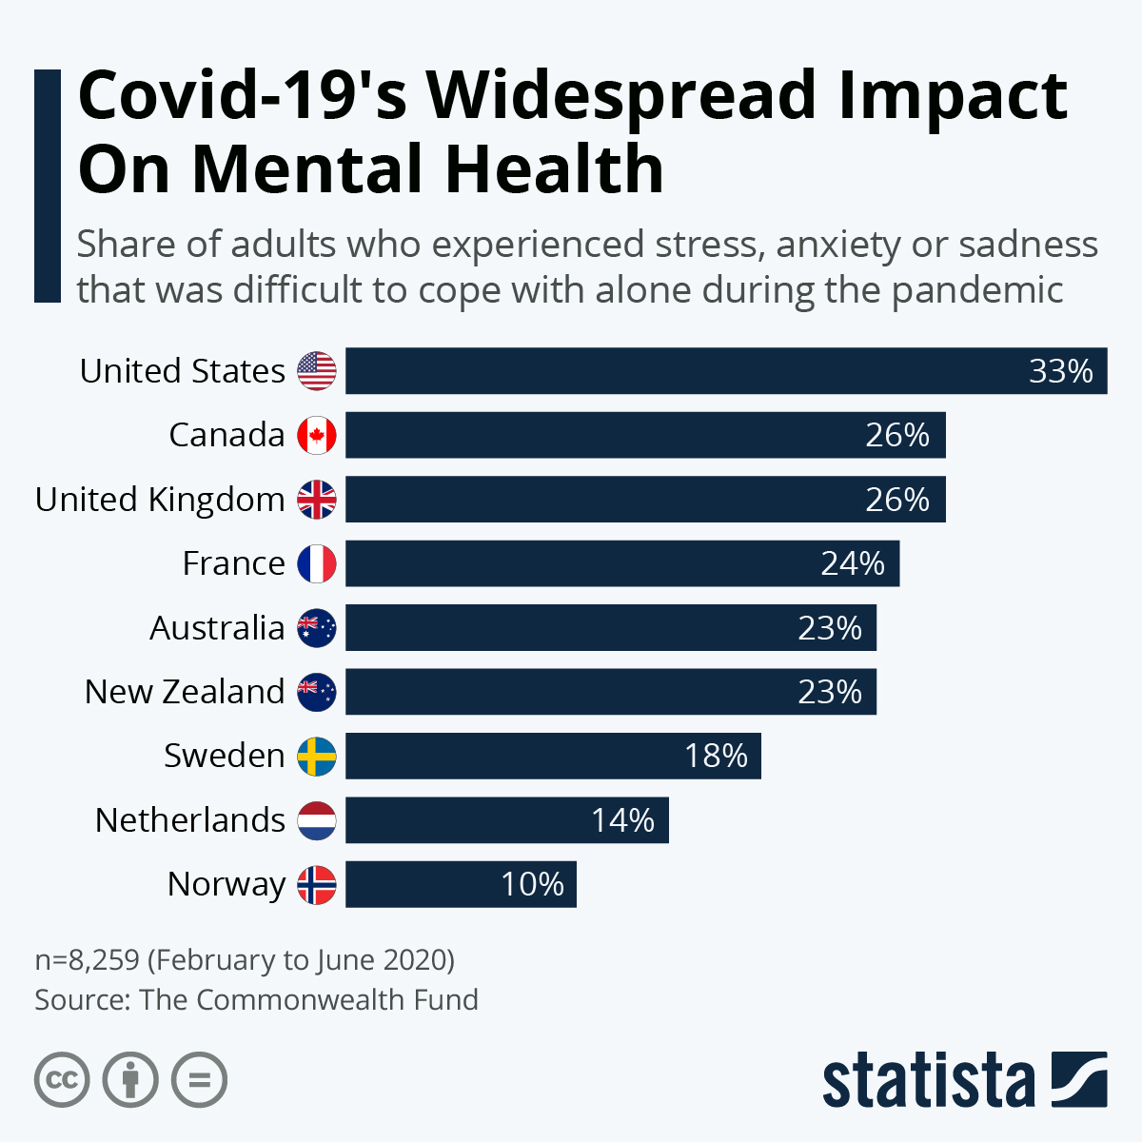
Impact of COVID-19
Public Health England has been monitoring population mental health throughout the pandemic using a range of surveys close to real-time data. This shows that self-reported mental health and wellbeing at a population level (including in anxiety, stress and depression) has worsened during the pandemic and remains worse than pre-pandemic levels.

